Slide 1
Parallel computing

Slide 2
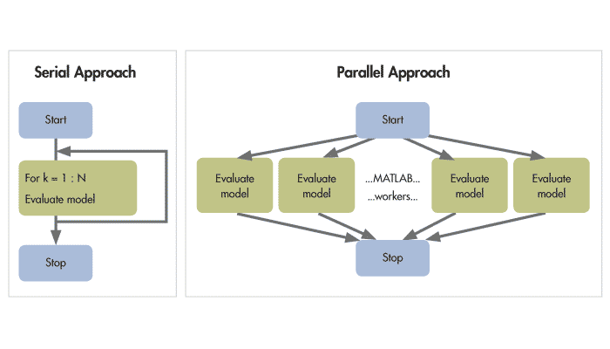
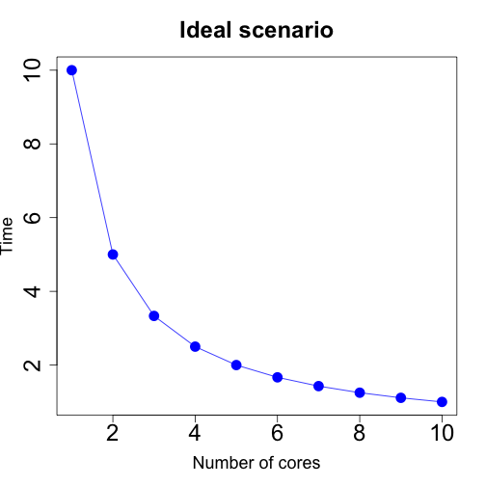
Dividing the work over multiple processors
R base -> 1 core by default
data.table -> multiple cores

Slide 3
Manual adding parallel computing
Useful in for loop situations
Multiple R packages available -> I used “parallel”
Lapply() analog functions
Which system? mac/windows/linux -> I only succeeded for windows
Which method? socket/fork -> I use socket
Socket: uses new R session per core -> investment
Fork: copies current R session to core (not for windows)
https://dept.stat.lsa.umich.edu/~jerrick/courses/stat701/notes/parallel.html

Slide 4
Steps
Code example
Note
Make a function for the process
Load needed packages within function
process <- function(input = x)
Determine number of cores you want to use
avialableCores <- detectCores()
usedCores <- ceiling(avialableCores /2)
Create the cluster
clust <- makeCluster(usedCores, outfile = paste0(path,"log.txt"))
Print to log file (no console info)
Copy objects
clusterExport(clust, varlist = c(“process", "x")
Run parallel
Y <- parLapply(cl = clust, c(1 ,2, …), function(i){process(input = i)})
End cluster
stopCluster(clust)

Slide 5
Difficulties
SQLite database lock: you can not write to database from several cores
Make temporary database on the core.
Connect temporary database with ATTACH statement.
Use the setup_timeout -> makeCluster(…, setup_timeout = 5000).
More suited to return R objects then updating the database.
Focus on most time consuming process, and keep the rest in serie
Debugging: not easy
Most of the time an object is missing.
Connection to a database needs to be set up within the core.

